Slide 1
Alberta Cup 1 & 2 Season Opener Dec 2 and 3

Slide 2
Thank you to our sponsors
Rocky Mountain Ski Lodge
SAVE ON FOODS
TRAIL SPORTS
BUFF
HAYWOOD SECURITIES
CANMORE BREWING COMPANY

Slide 3
Agenda
Welcome
Introductions: Jury, OC
Comments from the Jury
Weather Forecast
Stadium & Course
Ski Testing/Warm Up/Coaching/ Awards/Bibs
Schedule
Start Lists

Slide 4
Introduction of the Jury
Technical Delegate: Aaron Dodds
CCA Race Director: Mike Neary
Chief of Competition: Jim Hendry

Slide 5
Jury Comments
Welcome from Race Director
Off Track Concerns ICE snow guns snow making
Tight Course locations
Master Women Race distance

Slide 6
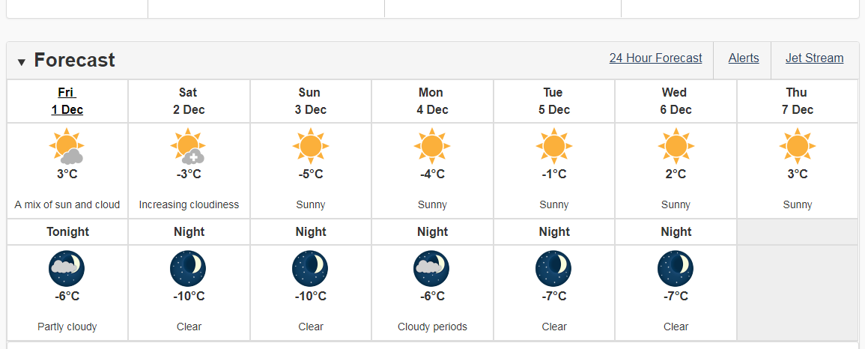
Weather Forecast

Slide 7
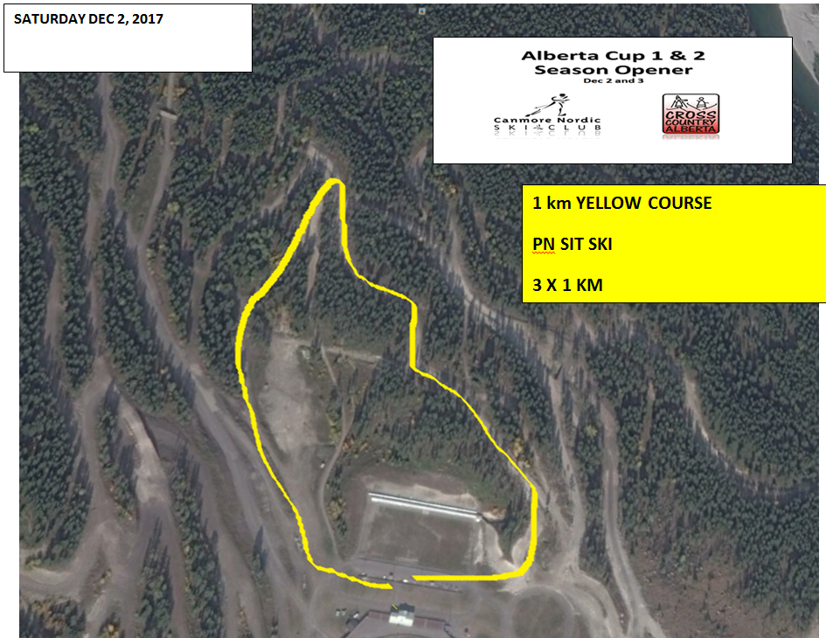

Slide 8
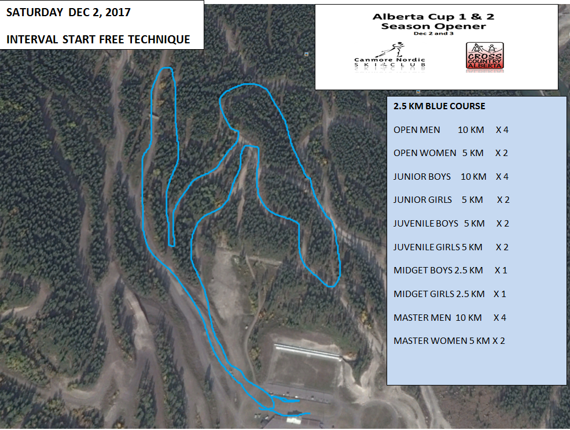
Master Women 10 km

Slide 10
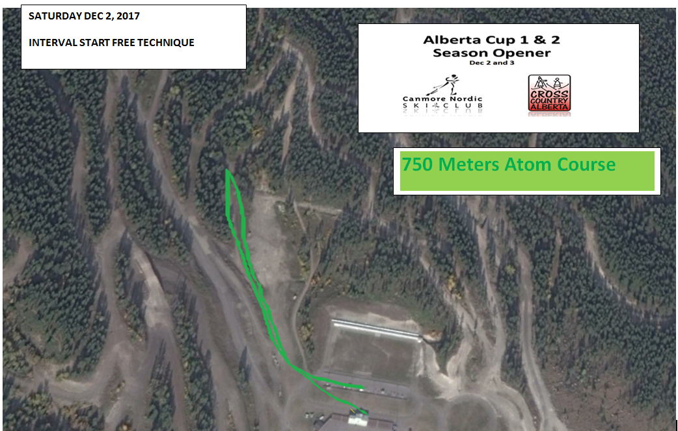

Slide 11
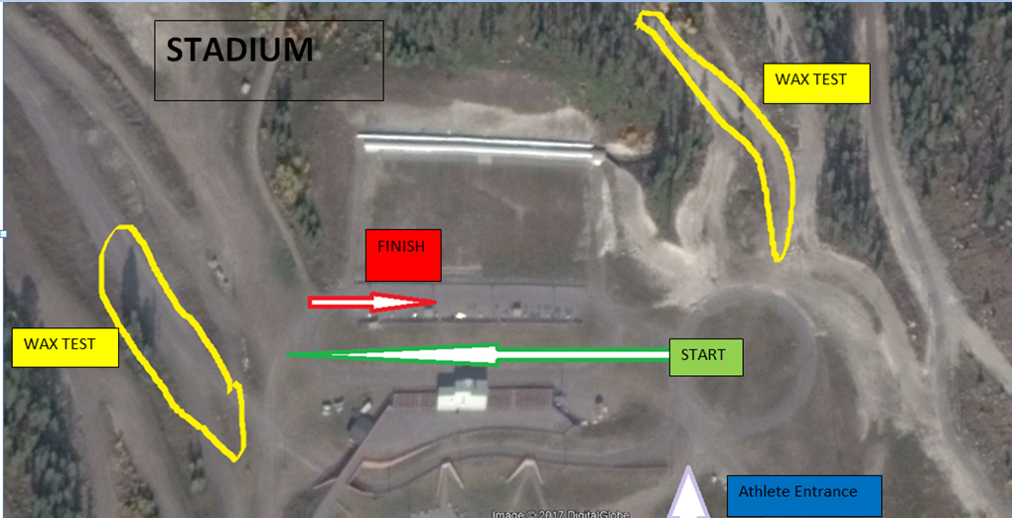

Slide 12
CCA Glide Waxing Protocol for All CATAGORIES
Cross Country Alberta requests that all coaches, athletes, wax technicians, and parents abide by a self- governed protocol while waxing skis for all athletes. This request applies to all local, regional and provincial events taking place in Alberta (e.g. club races, loppets, regional cup races, AB Cups, AB Youth Championships, and AB Winter Games). This request also applies to athletes traveling to Alberta from out-of-province or out-of-country. The recommended glide waxing protocol is as follows:
· Structure tools ARE permitted
· Non-Fluoro (NF) or Low Fluoro (LF) glide waxes ARE permitted
· Medium Fluoro (MF) or High Fluoro (HF) glide waxes are NOT permitted
· Pure Fluoro glide waxes (powders, pucks, blocks and liquid) are NOT permitted
· Cold weather powder additives and hardeners are NOT permitted
The adherence to this protocol is self-governed and is the responsibility of the coaches, athletes, parents and wax technicians.

Slide 13
Glide Wax Testing
Banff trail
First half of yellow course AFTER para sit ski
Absolutely NO skiing backwards on course!
Course closed 10 minutes before race start
There will be a 20 minute window for testing between 12:30 - 12:50
As Reminder AB Cups are No HF races

Slide 14
Wax Test

Slide 15
Wax Test

Slide 16
Warm up and Cool Down
Course closed 10 minutes before the start 8:50, 13:20
Start and Finish corridors are closed until race start – Athletes can view the Start and Finish on foot
Warm up and cool down in main X-C stadium

Slide 17
Athlete ENTRANCE to Start

Slide 18
SCHEDULE AM
Para Nordic sit men 09:00 3k 3 x1 k
Para Nordic sit women 09:04 3k 3 x 1 k
Open Men 09:30 10k 4x2.5
Para Nordic Standing M 10:32 10k 4x2.5
Junior Boys 10:35 10k 4x2.5
Open Women 11:00 5k 2x2.5
Junior Girls 11:13 5k 2x2.5
Juvenile Boys 11:45 5k 2x2.5
Juvenile Girls 12:15 5k 2x2.5

Slide 19
SCHEDULE PM
Atom 13:30 750 m
PeeWee 13:35 1.5 km
Mini Midget B 13:45 1.5 km
Mini Midget G 14:00 1.5 km
Midget B 14:30 2.5k 2.5x1
Midget G 15:00 2.5k 2.5x1
Master M 15:30 10 k 2.5 x4
Master W 15:35 10 k 2.5x4

Slide 20
Coaching on Course We have limited terrain out there and the course is quite narrow in places, Please be very aware of racers while moving around the course! Coaches are on Foot! Only competitors on Skis

Slide 21
Awards
Awards will take place on the paved area outside the Biathlon Building
Morning Race awards will be presented at asap
Afternoon Race awards at 16:15

Slide 23
Good Luck!

Slide 24
Alberta Cup 1 & 2 Season Opener Dec 2 and 3

Slide 25
Introduction of the OC
Chief of Competition – Jim Hendry
Race Office – Jeanie Godfrey
Course – Eric Trouillot
Stadium – Greg Manktelow
Timing – Cindy Low
Controls – Elliot Steinberg
Medical- Wendy McGregor
Volunteers – Jen Carlson
Canmore Nordic Center – Briony Willaims

Slide 26
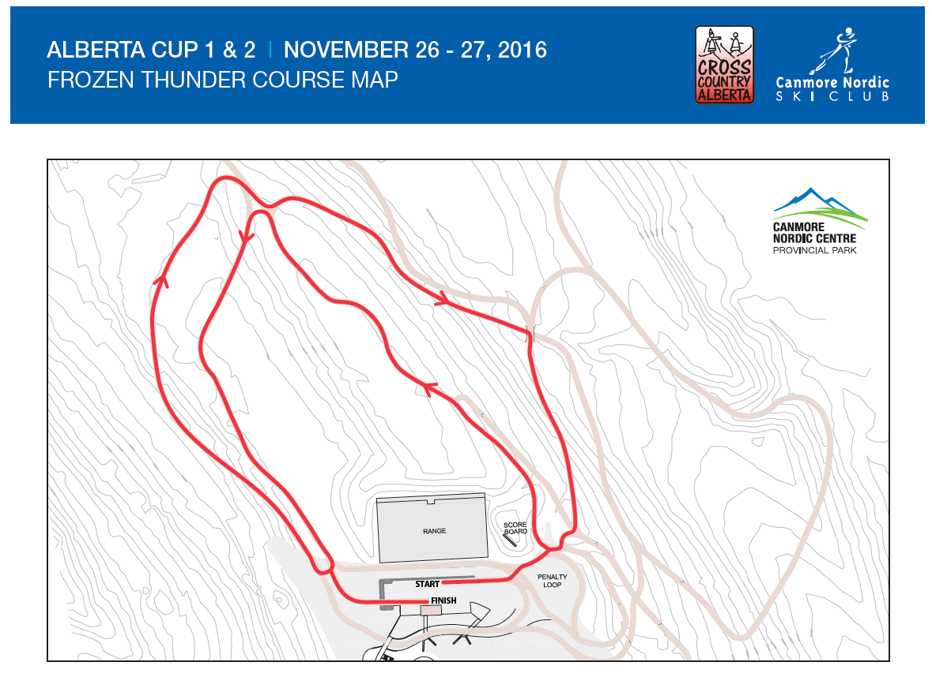
Course
Saturday Start Times & Laps:
Open Men 9:30 - 7.5 Laps
Master Men 10:30 - 6.5 laps
Junior Boys 10:40 - 4.5 laps
Open Women 11:30 - 4.5 laps
Master Women 11:50 - 6.5 laps
Junior Girls 11:55 - 3.5 laps
M-Midget Boys 13:10 - 1.5 laps
M- Midget Girls 13:20 - 1.5 laps
Midget Boys 13:30 - 2.5 laps
Midget Girls 13:45 - 2.5 laps
Juvenile Boys 14:15 - 3.5 laps
Juvenile Girls 14:35 - 2.5 laps

Slide 27
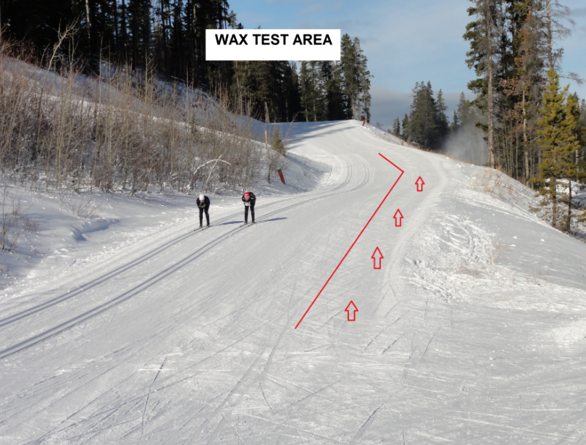
Wax testing
This is not the actual Wax Test area, but this will be the Set up

Slide 28
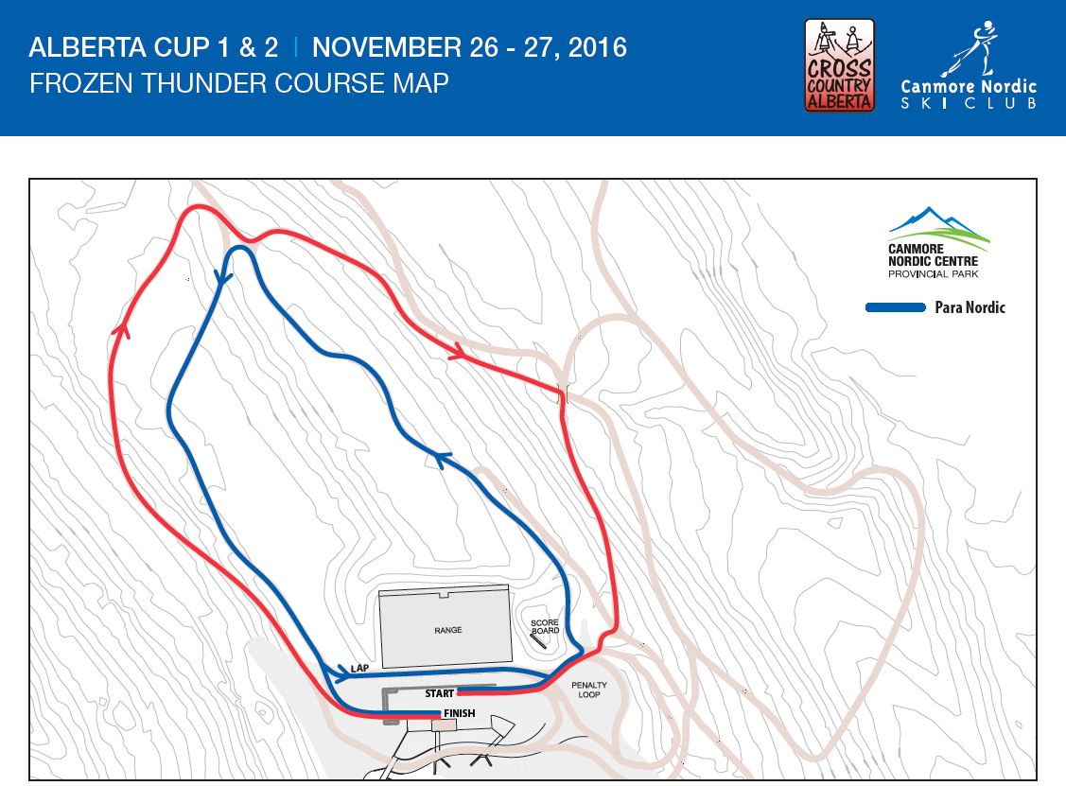
Para Nordic Course & .9 Loop
Saturday Start Times & Laps:
Para Nordic SS 9:00 – 6 laps
Atoms/Pwees 13:00 – 1 laps

Slide 29
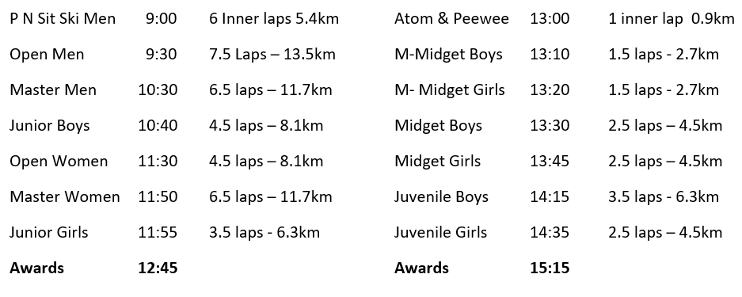
Schedule Saturday November 26th – Interval Start Free

Slide 30
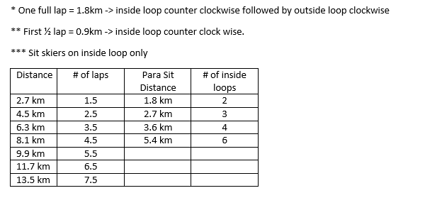
Course Information
All athletes are responsible for counting their own laps!

Slide 31
PN Sit Ski Men 09:00 3K 3 X1KM Atom 1300 750 M
Open Men 09:30 10K 4X2.5 P WEE Boys 13:15 1.5K
Junior Boys 10:20 10K 4X2.5 P WEE GIRLS 13:25 1.5K
Open Women 10:40 5K 2X2.5 M Midget Boys 13:30 1.5K
Junior Girls 11:15 5K 2X2.5 M Midget Girls 14:00 1.5 K
Juvenile Boys 11:45 5K 2X2.5 Midget Boys 14:30 2.5K 1X2.5
Juvenile Girls 12:15 5K 2X2.5 Midget Girls 15:00 2.5K 1X2.5
Awards 13:05 Master Men 15:35 10 KM 4X2.5
Master Women 15:42 5KM 2X2.5
AWARDS 16:15

Slide 32
Schedule Dec 2 –Interval Start Free
PN Sit Ski Men 09:00 3K 3 X1KM Atom 1300 750 M
Open Men 09:30 10K 4X2.5 P WEE Boys 13:15 1.5K
Junior Boys 10:20 10K 4X2.5 P WEE GIRLS 13:25 1.5K
Open Women 10:40 5K 2X2.5 M Midget Boys 13:30 1.5K
Junior Girls 11:15 5K 2X2.5 M Midget Girls 14:00 1.5 K
Juvenile Boys 11:45 5K 2X2.5 Midget Boys 14:30 2.5K 1X2.5
Juvenile Girls 12:15 5K 2X2.5 Midget Girls 15:00 2.5K 1X2.5
Awards 13:05 Master Men 15:35 10 KM 4X2.5
Master Women 15:42 5KM 2X2.5
AWARDS 16:15

Slide 33
Jury Report

